Slide 1
Emergency +
Team Name: Error Cycle
Team Leader: Sumiea Akter
Member’s: Kowshik Mozumder
IKHTIAR HOSEEN
Department of Software Engineering

Slide 2

Introduction
Emergency +
The Emergency + is an innovative and advanced solution designed to revolutionize the traditional ambulance services by leveraging the power of technology. It is a digital platform that aims to enhance the efficiency, accessibility, and effectiveness of emergency medical services.

Slide 3
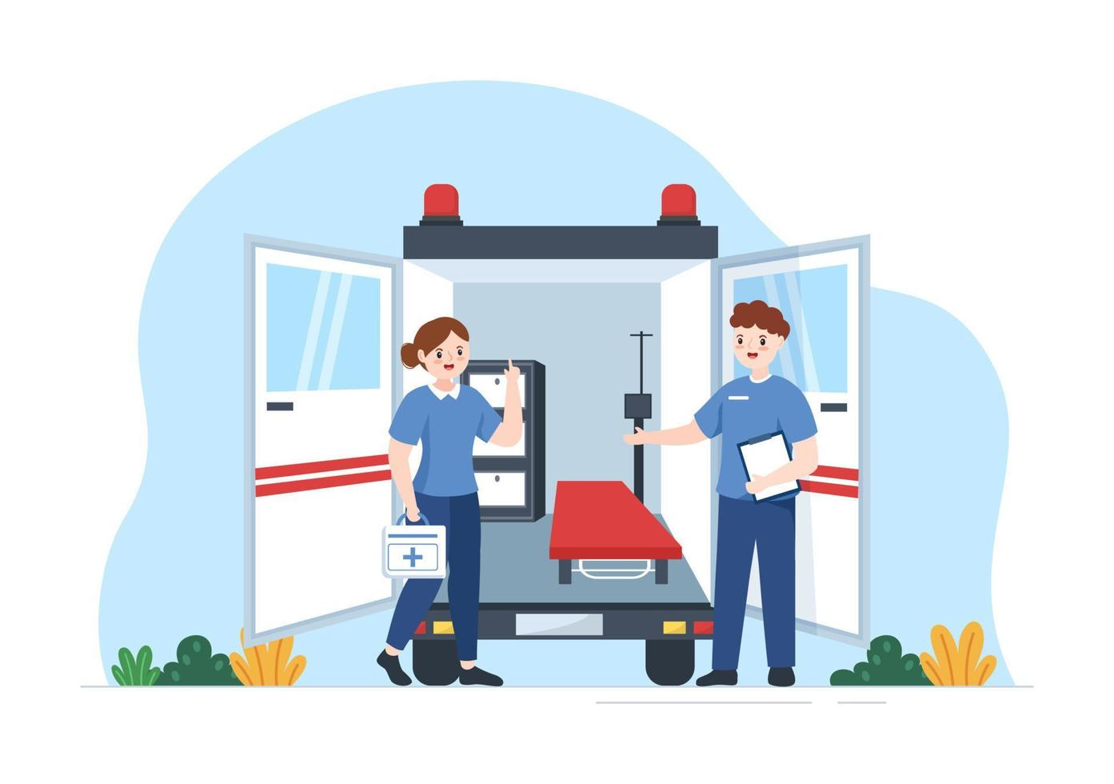
Why do we need this Project
Faster response times
Optimal resource allocation
Enhanced communication
Improved access and coverage
Efficient patient care
Data-driven decision making
Traffic clearance assistance

Slide 4
Features
Ambulance Location
Driver Profile
Confirm Booking
Client Information
Live Location
Alert Traffic Police
Help Line

Slide 5
Unique Features
Alert traffic police
Help line
Provides full security

Slide 6
Potential Revenue Streams
Partnerships with healthcare providers
Advertising and sponsorships
Data analytics and insights
Additional services and upgrades
Insurance partnerships
Driver’s monthly fee

Slide 7
How To Reach the Emergency + to people Effectively
Online presence
Social media marketing
Collaborations with healthcare providers
Community engagement
Media coverage
Partnerships with emergency services
Word-of-mouth referrals
Continuous feedback and improvement

Slide 8
Future Improvement
Hospital system added
Automatic clients access to nearest ambulance
Mobile app improvement

Slide 9
Q&A

Slide 10

Thank You

